Slide 1



Presented By:
Mohit
Manish
Namit
PLANTHUB

Slide 2


Table Of Content
Content List
01.
03.
Amazing Facts and Information about Plants
Scope of Our Idea
02.
Selling Plants & Pots

Slide 3

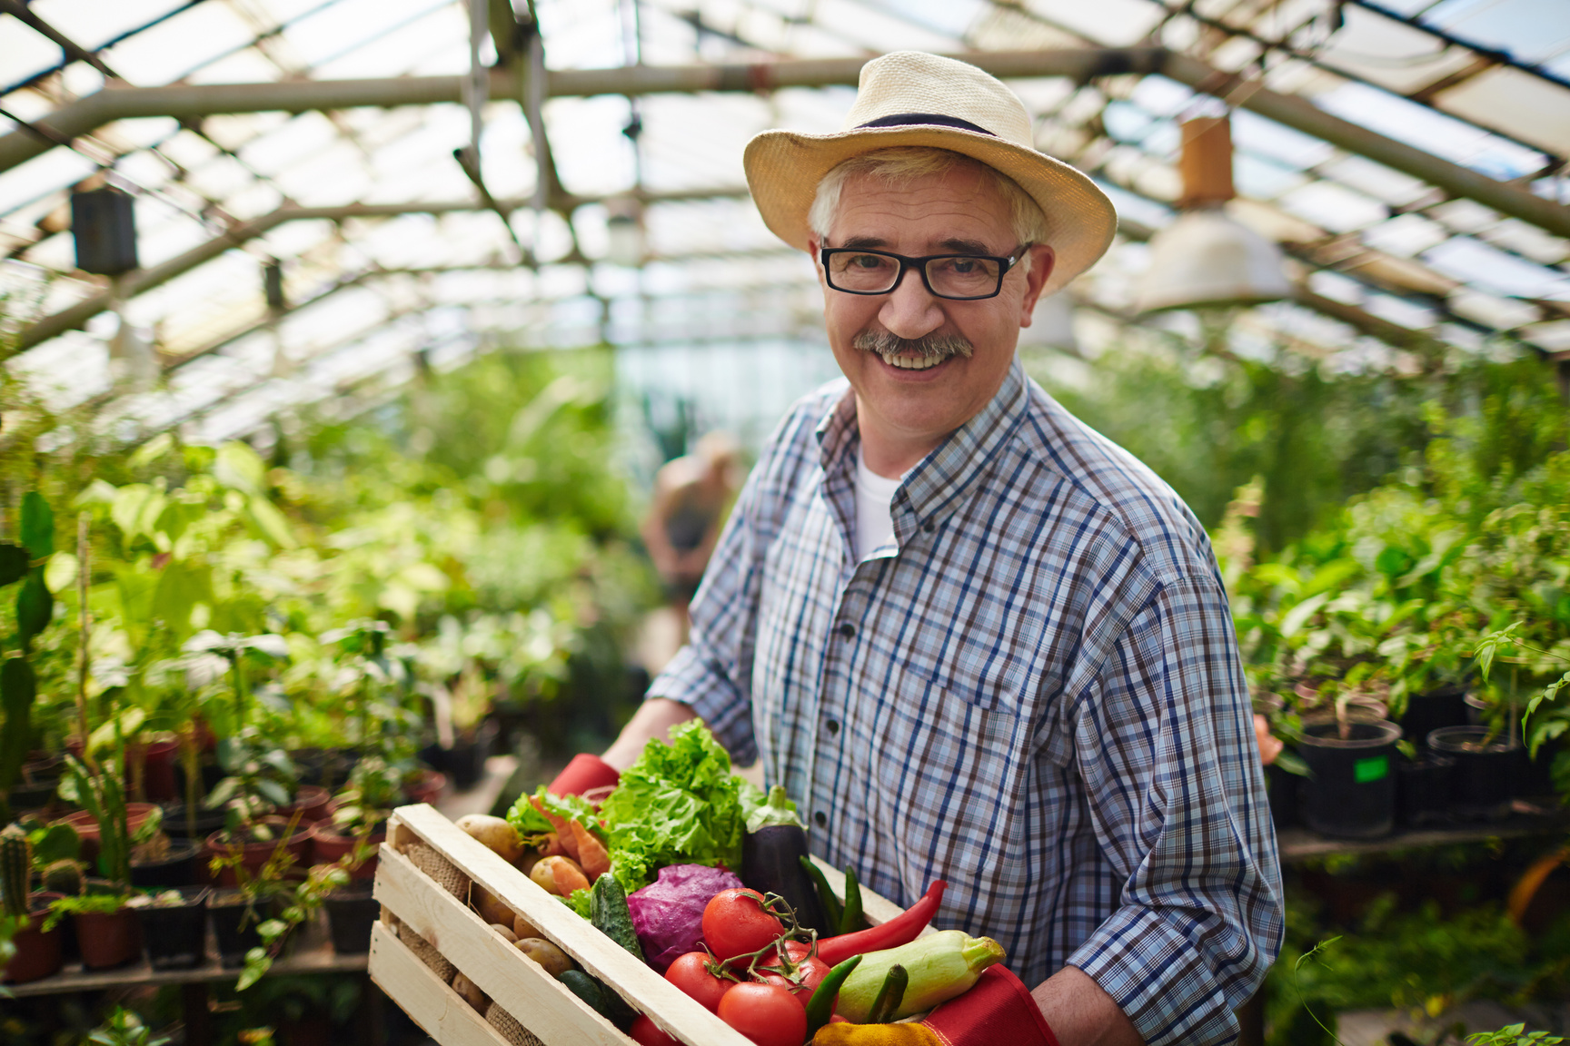
Problem Statement
Most people are dependent on local vendors for buying plants & pots at high prices and usually they don't trust online purchasing of plants because of quality issues & few more reasons. Few people are willing to have plants but they don't have time or proper knowledge about maintenance of plants.
Also, the niche market wants plants but doesn't want to go outisde to buy them.

Slide 4

Solution
We are going to build a website which will show facts about plants and sell plants & pots. We will contract local nurseries for the supply of plants and deliver those plants to our customers. We will provide proper information about maintenance of plants or may provide maintenance by ourselves.
100%
Quality
Plant Hub
High-Quality Plants at Lowest Prices

Slide 5



Our Vision
& Mission
Value
Movement Goal
Plants possess the ability to adapt to changing seasons and this helps them to thrive. They accept the challenge in front of them and adjust themselves accordingly. We inflict this plant value and are ready to change world's mindset
Vision
To be the number one plant selling brand in the world
in terms of goodness and convenience in services
Mission
We are here to provide optimal service to customers by
respecting all their requests and using new technology
as a step to become the number one brand.

Slide 6

Information & Facts
Our Feature
01
You can get a lot of amazing facts and information about plants from our app.
Introduction
Buy Plants
02
You can buy Fresh & best Quality Plants from our application.
Buy Plant Pots
03
You can buy designer plant pots from our application.
Another Help
04
We will provide complete information about maintenance of plants or also provide maintenance services

Slide 7
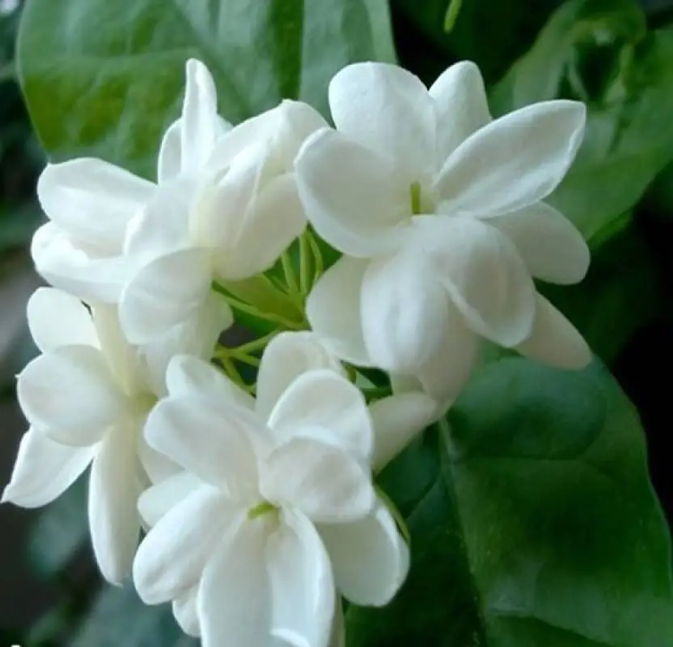
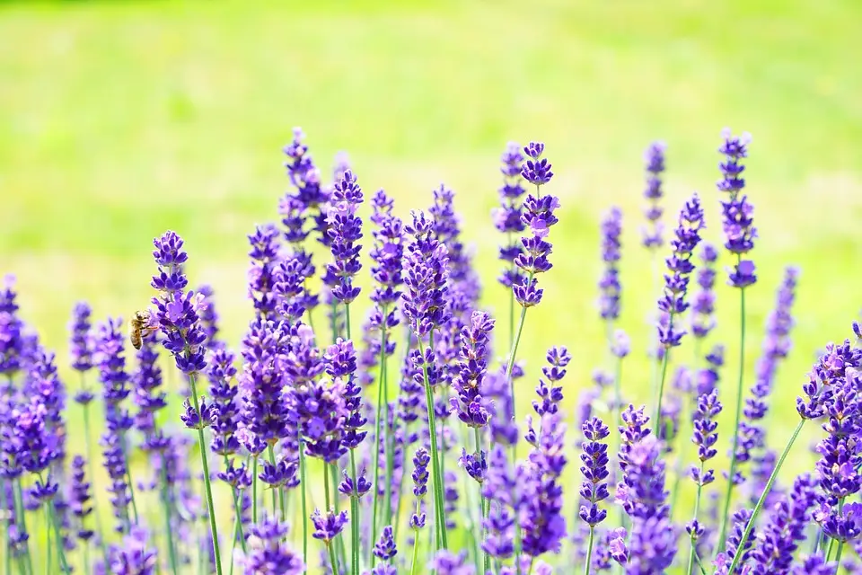
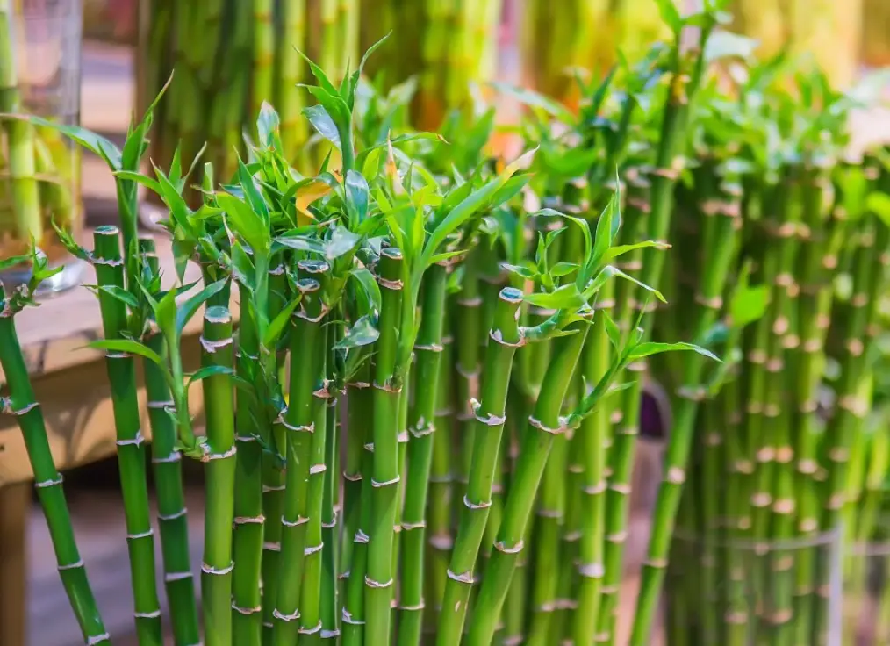
Lucky Bamboo
The lucky bamboo or the bamboo plant brings luck in health as well as love life. It is a very low-maintenance plant.
Plant Makes You Happy
Jasmine
Lavender
Jasmine is planted mainly for its beautiful flowers and is enjoyed as a house plant. The plant attracts positive energy and helps in nourishing relationships.
Lavender is also known for bringing happiness and relaxation in a person’s life. It should be kept in a place where you can smell it often in order to get the best effect.

Slide 8





The Team Behind Us
Teamwork Is The Key
Manish Kumar Sharma
Mohit Malik
Namit Kumar
Co-Founder
Founder
Co-Founder

Slide 9



Try Our
Great App
Awesome Product
World's best User friendly application telling you amazing facts about flowers & plants.
App Interface
77%
Speed
86%

Slide 10
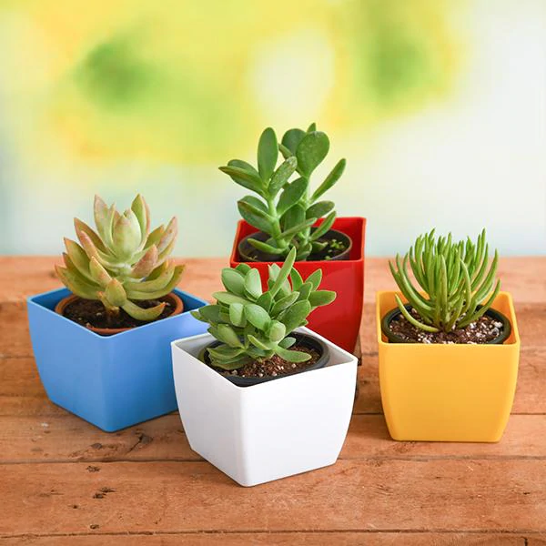

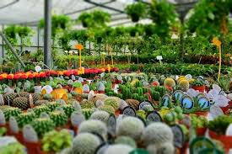
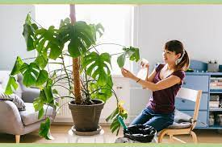
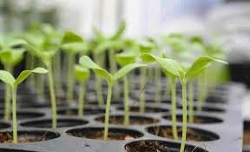

Plant Hub
Gallery
Our Picture

Slide 11
Great Price List
Offer For You
50%
FREE
BENEFITS
PRICES
HOME DELIVERY
MAINTENANCE
For first 100 customers
All plants at 50% Price
Fresh plants
Free home delivery
For the first 10 orders
Delivery within 1-3 days
We will provide all information about maintenance
Also offer you best maintenance

Slide 12
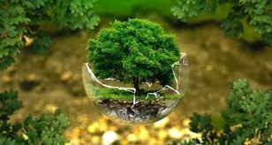
Future Scope
Selling Seeds & tools
01
We will sell seeds of different plants & gardening tools to our customers.
Servicing Package
02
Anyone could buy our servicing package which will come with different services for maintenance of plants.
Contracts
03
we may take large contracts of public places like school, colleges or hospitals to setup plants & maintenance.

Slide 13


Get Connected With Us
Contact Information
7065363038
planthub@gmail.com
planthub@gmail.com
Gurgaon, Haryana

Slide 14
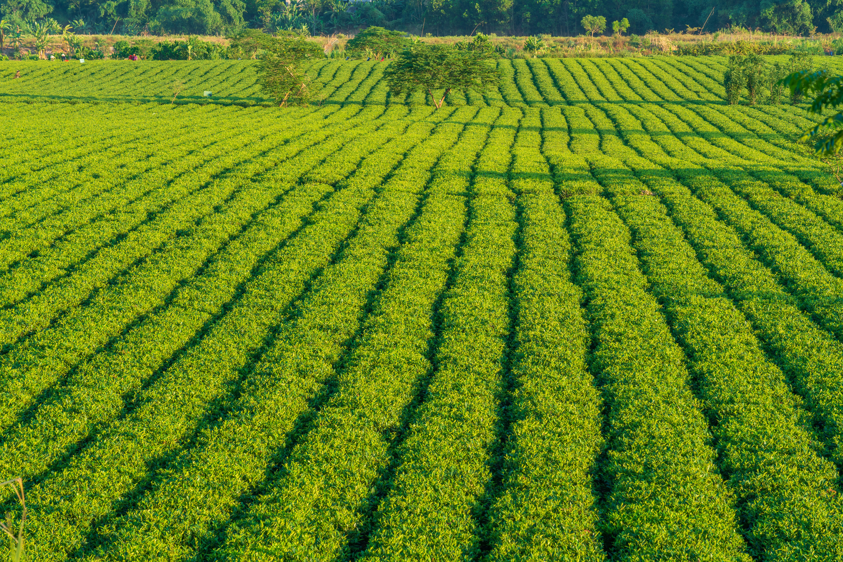

03/04/2022
THANKS

